Slide 1

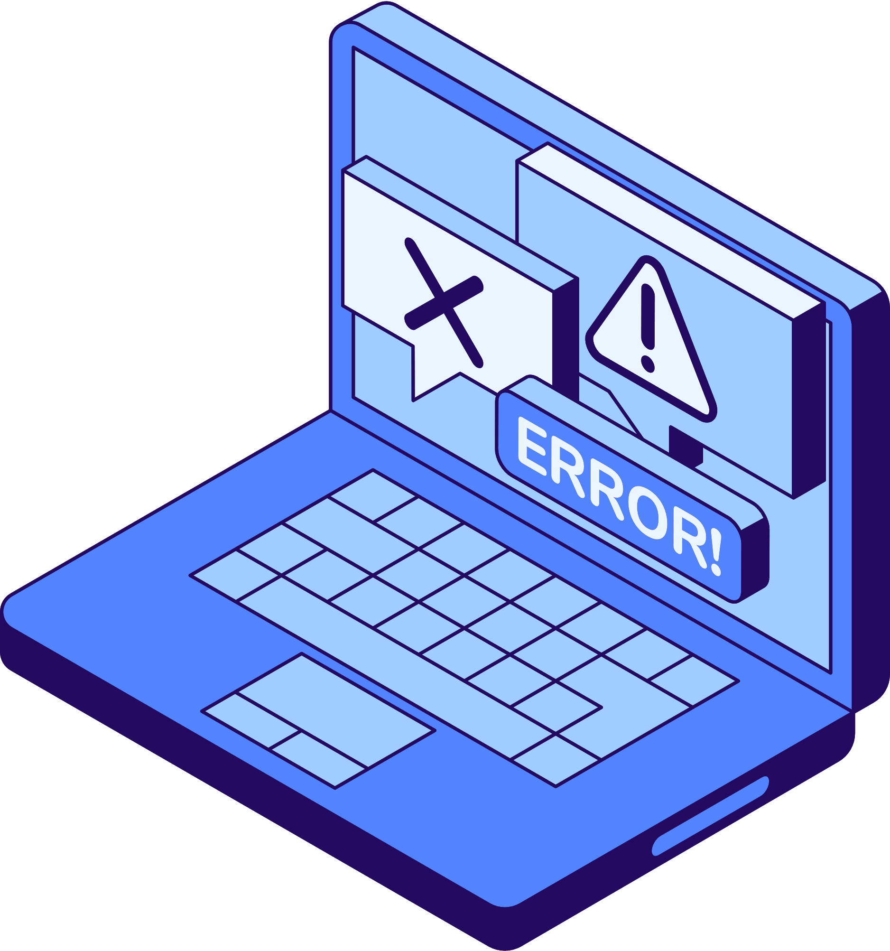


Topic Name: Cyber Security
Student Name: Mahammad Nazil
Division: A(A3)

Slide 2
CYBER
SECURITY
Cyber Security Mahammmad Nazil(154) 02

Slide 3

WHAT IS
CYBER SECURITY ?
Cyber security is the practice of protecting digital devices, networks, and sensitive data from cyber threats such as hacking, malware, and phishing attacks.” It involves a range of strategies, technologies, and best practices designed to safeguard computers, networks, and data from cyber attacks.
In short, cybersecurity keeps your online world safe and secure. It ensures that sensitive information remains confidential, intact, and accessible only to authorized users. Whether it’s securing personal information, financial transactions, or corporate databases.
Cyber Security Mahammmad Nazil(154) 03

Slide 4



CYBER IMPORTANCE
Cyber Security is important because the government, corporations, and medical organizations, collect military, financial, process, and store unprecedented amounts of data on a computer and other properties like personal information, and this private information exposure could have negative consequences.
Cyber Security Mahammmad Nazil(154) 04

Slide 5

1. Malware
Harmful software like viruses, worms, and spyware that can damage or steal data.
COMMON
2. Phishing
Fake emails or messages tricking you into giving personal information.
CYBER THREATS
3. Ransomware
A type of malware that locks your files and demands money to unlock them.
Cyber Security Mahammmad Nazil(154) 05

Slide 6
4. Denial-of-Service (DoS) Attack
Overloading a website or system to make it stop working.
COMMON
5. Man-in-the-Middle Attack
Hackers secretly intercept your data while it’s being transferred.
CYBER THREATS
6. SQL Injection
Hackers insert malicious code into a website’s database to steal data.
Cyber Security Mahammmad Nazil(154) 06

Slide 7
7. Zero-Day Attack
Exploiting software vulnerabilities before a fix is available.
8. Insider Threats
Employees or trusted people misusing access to steal or leak information.
COMMON
CYBER THREATS
9. Spyware
Software that secretly monitors what you do on your device.
10. Social Engineering
Tricking people into giving away confidential information.
Cyber Security Mahammmad Nazil(154) 07

Slide 8

CYBER
ATTACK
A Cyber Attack is an attempt by hackers or malicious actors to damage, steal, or gain unauthorized access to computer systems, networks, or data. Cyber attacks can target individuals, businesses, or even governments.
Cyber Security Mahammmad Nazil(154) 08

Slide 9


SOME FAMOUS CYBER ATTAKS
1. WannaCry Ransomware Attack (2017)
A ransomware virus spread worldwide, locking computers and demanding Bitcoin payments to unlock files. Affected 200,000+ computers in 150+ countries,
2. Yahoo Data Breach (2013-2014)
Hackers stole personal data from 3 billion Yahoo accounts, including emails, passwords, and security questions. Largest data breach in history, leading to lawsuits and a major drop in Yahoo’s valuation.
Cyber Security Mahammmad Nazil(154) 09

Slide 10




ADVANTAGES OF CYBER SECURITY
Protects Personal and Business Data
Prevents Financial Loss
Ensures Safe Online Transactions
Improves System & Network Security
Cyber Security Mahammmad Nazil(154) 10

Slide 11




DISADVANTAGES OF CYBER SECURITY
High Cost
Complexity & Maintenance
Reduced System Performance
No 100% Protection
Cyber Security Mahammmad Nazil(154) 11

Slide 12

Definition
Ethical hacking is the practice of testing and securing computer systems by finding and fixing vulnerabilities before hackers can exploit them.
ETHICAL
HACKING
Purpose
Helps organizations protect sensitive data, prevent cyber attacks, and strengthen security defenses.
Techniques Used
Ethical hackers use penetration testing, vulnerability scanning, and social engineering to identify weaknesses.
Cyber Security Mahammmad Nazil(154) 12

Slide 13


Definition
Penetration testing (Pen Testing) is a simulated cyber attack on a system, network, or application to identify security weaknesses before hackers exploit them.
Purpose
Helps organizations find vulnerabilities, test defenses, and improve security measures to prevent real cyber attacks.
Types of Penetration Testing
Black Box: Tester has no prior knowledge of the system.
White Box: Tester has full knowledge of the system’s structure.
Gray Box: Tester has partial knowledge, simulating an insider attack.
PENETRATION
TESTING
Cyber Security Mahammmad Nazil(154) 13

Slide 14
Types Of Cyber Security
Network Security
Application Security
Cloud Security
Web Security
Mobile Security
IOT Security
Virus Security
Cyber Security Mahammmad Nazil(154) 14

Slide 15
Cyber Security Trends Chart.
Cyber Security Mahammmad Nazil(154) 15

Slide 16
THANK YOU!
Cyber Security Mahammmad Nazil(154) 16

